Slide 1

Supporting Decision Making under Deep Uncertainty
Prof. dr. ir. Jan H. Kwakkel
Multi-Actor Systems department
Faculty of Technology, Policy and Management

Slide 2
So what is deep uncertainty?
Deep uncertainty refers to the situation where the various parties to a decision do not know or cannot agree on
The system model that relates actions to consequences
The prior probability distributions to put on the inputs to the system model(s)
Which consequences to consider and their relative importance
Deep uncertainty often involves decisions made over time in dynamic interaction with the system.
Kenneth Arrow first used the term in the late 1990s to characterize the climate change debate
Formal work on dealing with deep uncertainty started in the early 2000s at the RAND Corporation and TU Delft.
Deep uncertainty is also known as radical uncertainty, Knightian uncertainty, or uncertainty proper

Slide 3
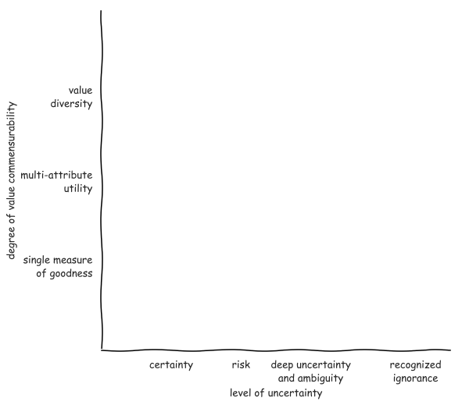
Notes:
Pas op met woord methode
Ontbreken van theorie en effectieve methode

Slide 4
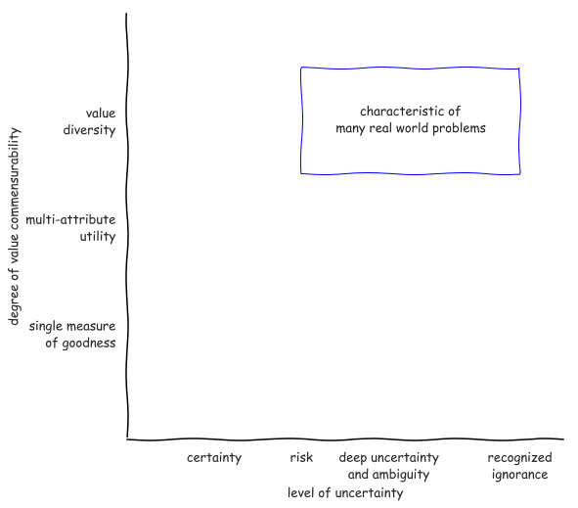
Notes:
Pas op met woord methode
Ontbreken van theorie en effectieve methode

Slide 5
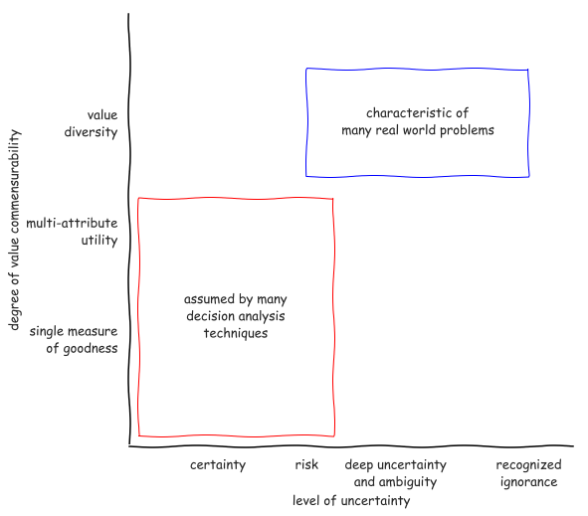
Notes:
Pas op met woord methode
Ontbreken van theorie en effectieve methode

Slide 6
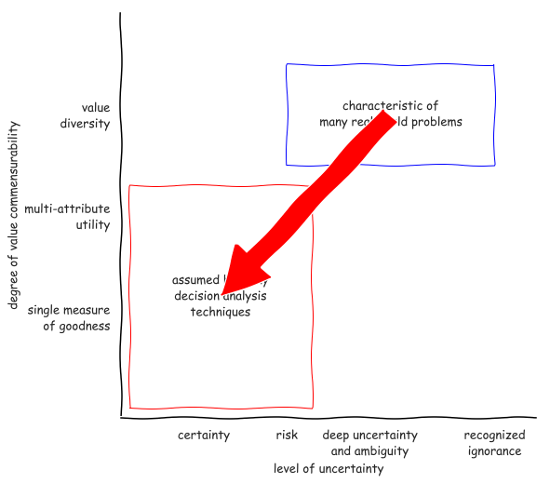
Notes:
Pas op met woord methode
Ontbreken van theorie en effectieve methode

Slide 7
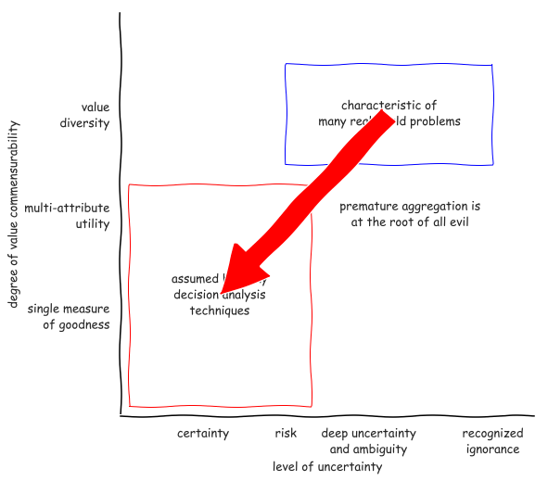
Notes:
Pas op met woord methode
Ontbreken van theorie en effectieve methode

Slide 8
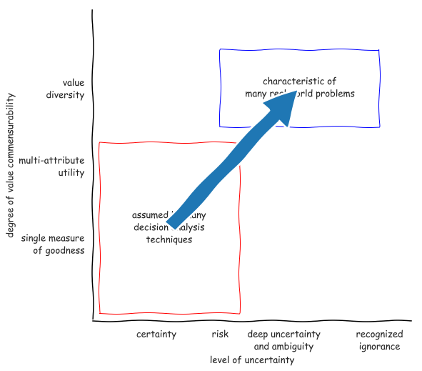
Notes:
Pas op met woord methode
Ontbreken van theorie en effectieve methode

Slide 9
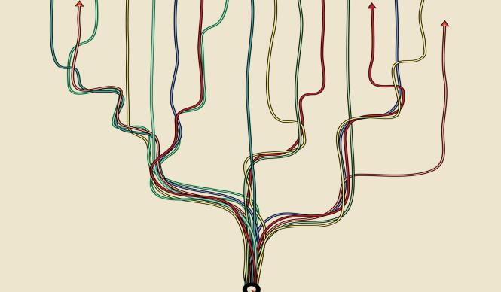
Why use models?
Argument from complexity
supplement human reasoning
sensitivity to initial conditions
Argument from uncertainty
When confronted with uncertainty, instead of making an assumption, explore the consequences of alternative assumptions systematically to identify differences that make a difference
Notes:
Multiplicity of legitimate perspectives
Does l’esprit de geometrie have a place?

Slide 10
Decision-making under deep uncertainty
Decision aiding – the aim of decision advise is to facilitate learning about a problem and potential courses of action, not to dictate the right solution. This entails a shift from a priori to a posteriori decision analysis.
Adaptive planning – plans should be designed from the outset to be adapted over time in response to how the future is unfolding
Exploratory scenario thinking– the future is uncertain and cannot be probabilistically constrained, we need systematic what-if analysis of the future which serves as a test bed for candidate strategies

Slide 11
Aiding decision making

Slide 12

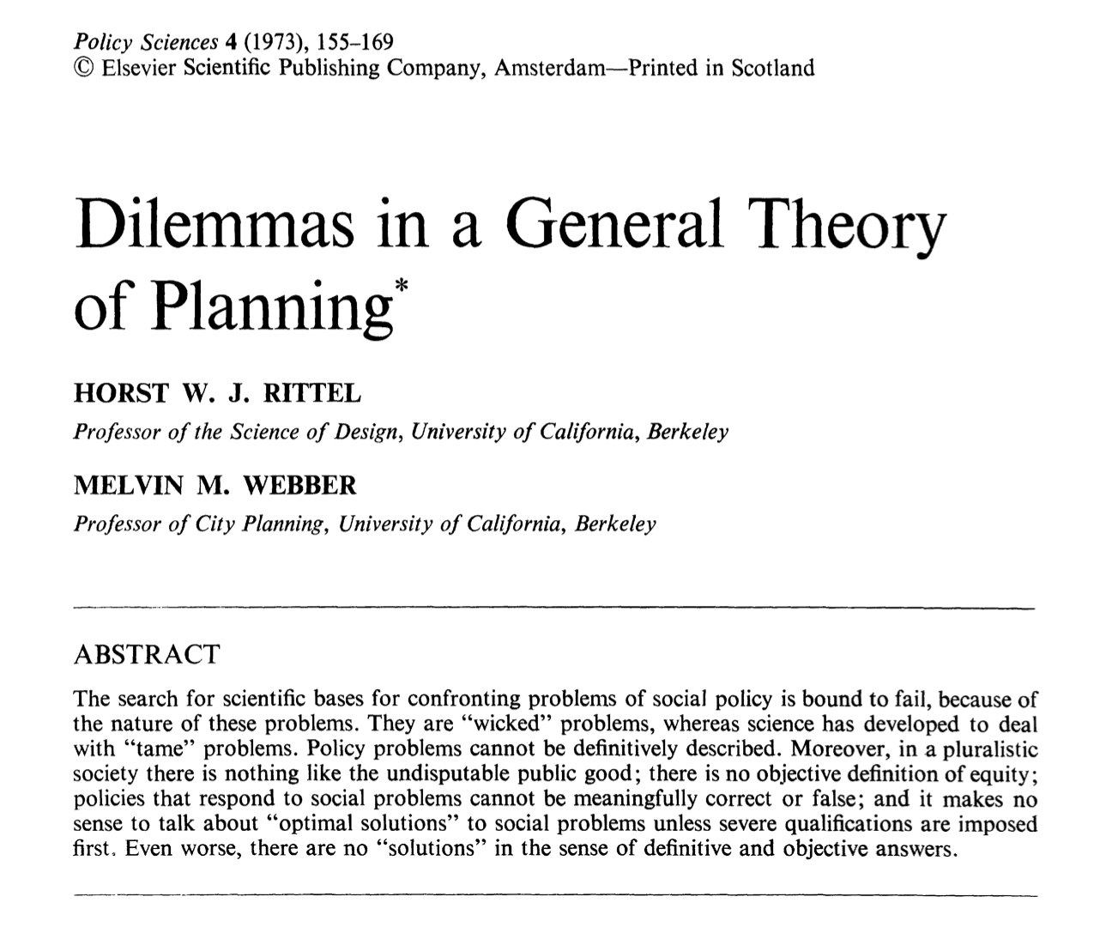
What is the role of models in decision making?
Notes:
The task of an adaptive organism is to find the difference between an existing state and a desired state and then find the correlating process that will erase the difference.

Slide 13
Adaptive planning

Slide 14
Adaptation pathways
Action
A
Time horizon
100
years
Action
B
Pathway
Costs
Benefits
Co
-
benefits
Current
1
+++
+
0
situation
2
+++++
0
0
Action
C
3
+++
0
0
Action
D
4
+++
0
0
Changing conditions
5
0
0
-
0
6
++++
0
-
Time low
-
end scenario
10
70
80
90
100
7
+++
0
-
0
10
100
8
+
+
-
-
-
Time high
-
end scenario
70
80
90
9
++
+
-
-
-
Years
Transfer station to new
policy
action
Adaptation Tipping Point of a
policy action
(
Terminal
)
Policy action
effective

Slide 15
Exploratory scenario thinking

Slide 16
Often, more information can be captured in an ensemble of alternative plausible models than can be captured by any individual model.
Bankes (2002) 10.1073􏰅pnas.092081399

Slide 17
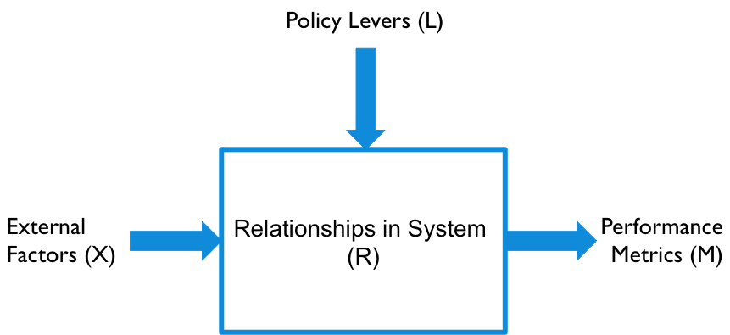
XLRM framework

Slide 18
Running a model as a function
X : uncertainties
Model structure uncertainties as well as exogenous forces
A point in uncertainty space is called a scenario
L : levers
A point in lever space is called a policy
Policies to be tested over the uncertainties
M : outcomes
Outcomes of interest

Slide 19
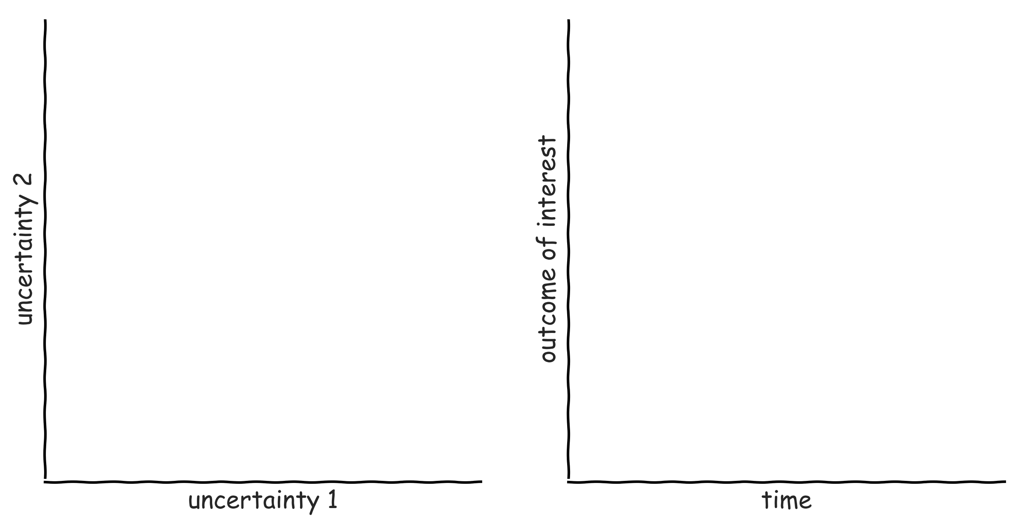
Exploratory modelling in a nutshell

Slide 20
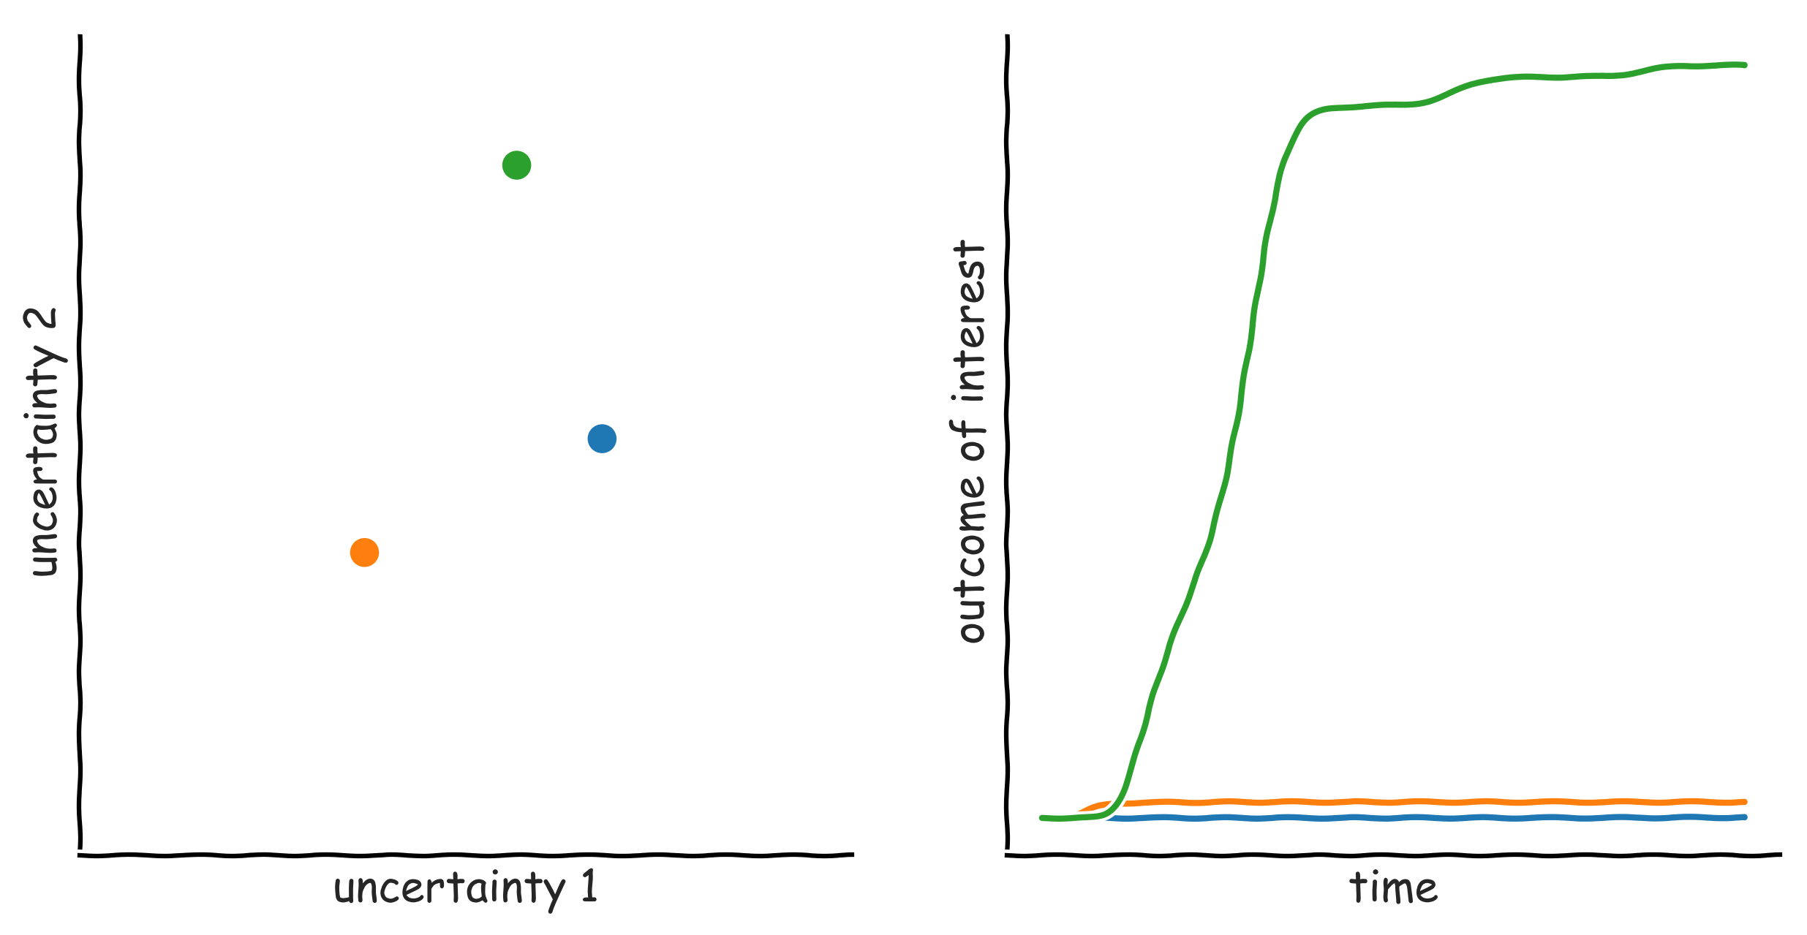
Exploratory modelling in a nutshell

Slide 21
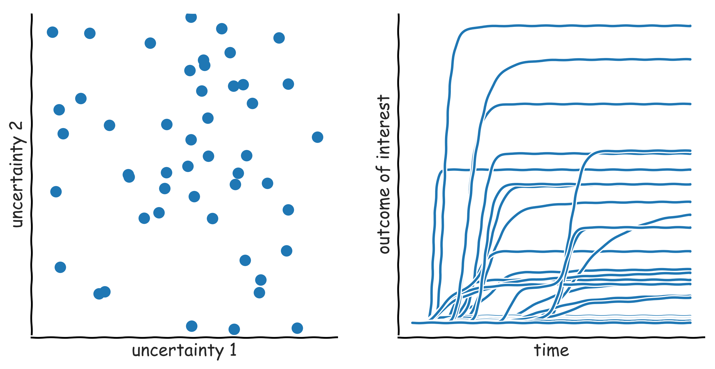
Exploratory modelling in a nutshell

Slide 22
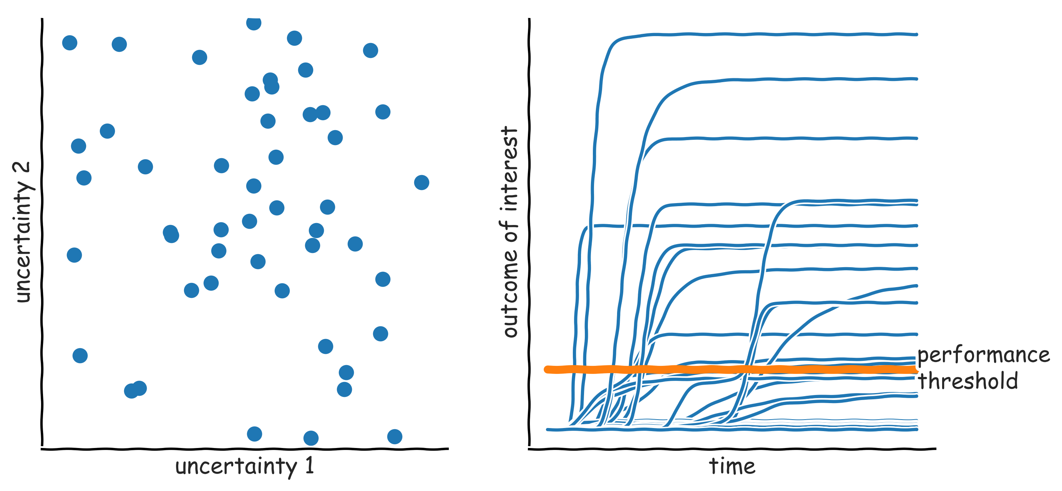
Exploratory modelling in a nutshell: scenario discovery

Slide 23
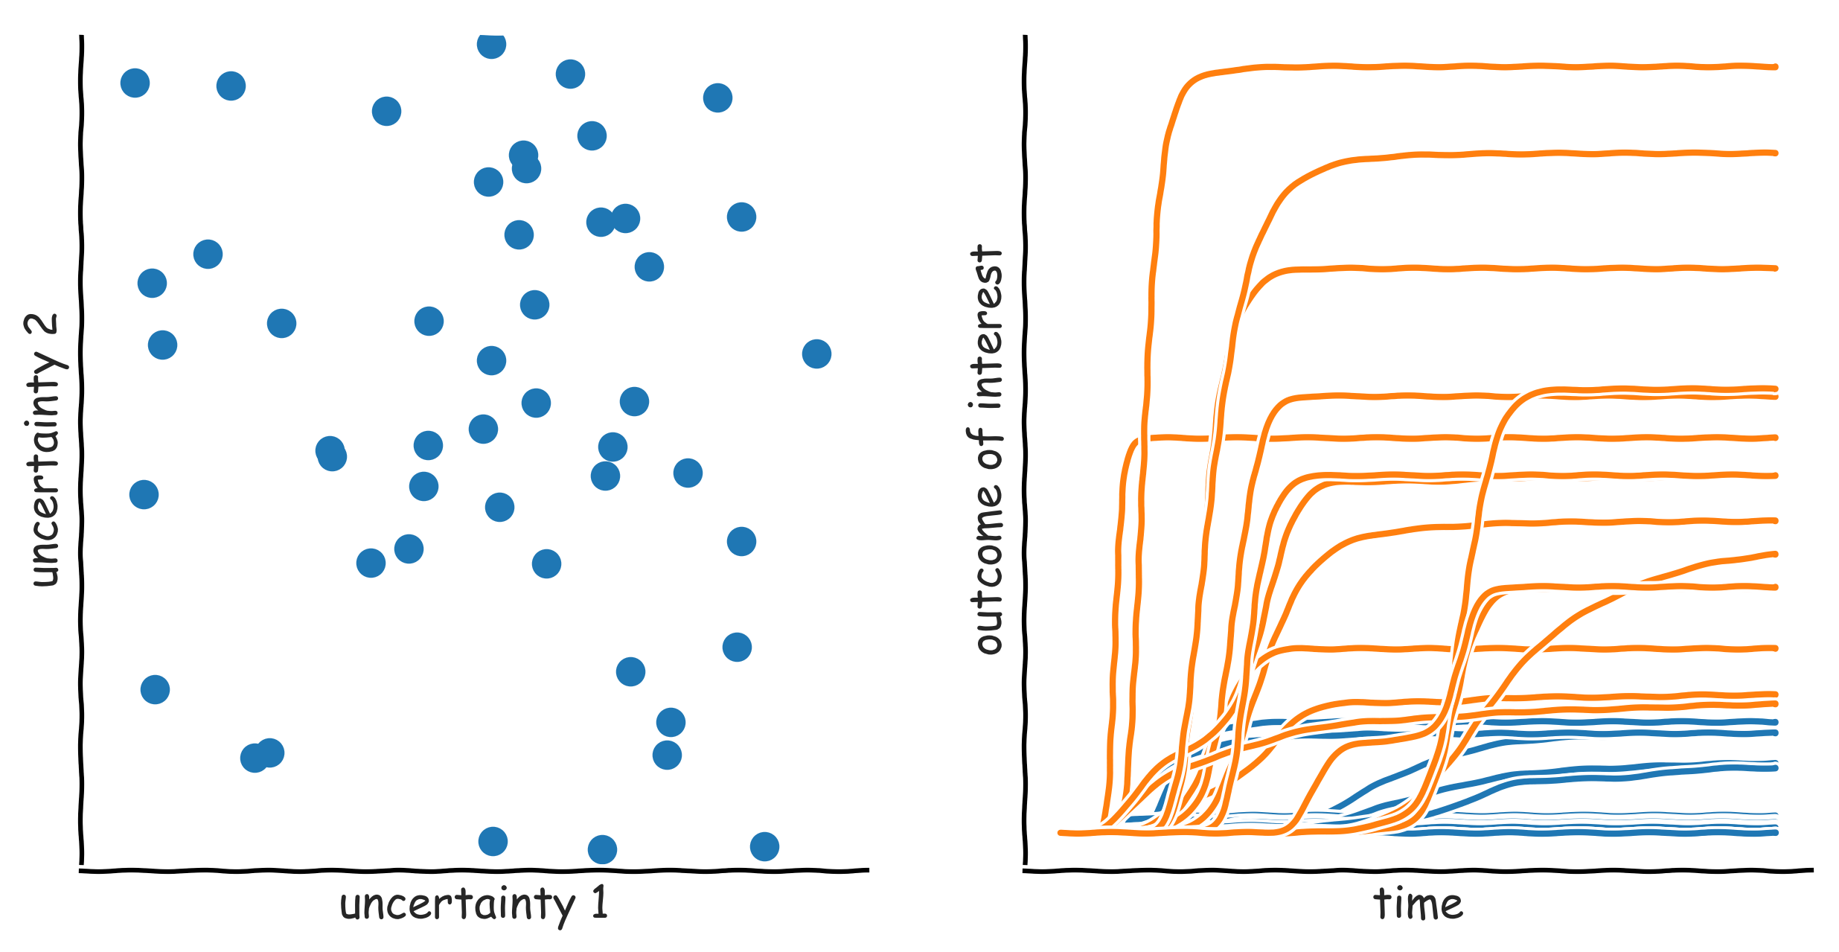
Exploratory modelling in a nutshell: scenario discovery

Slide 24
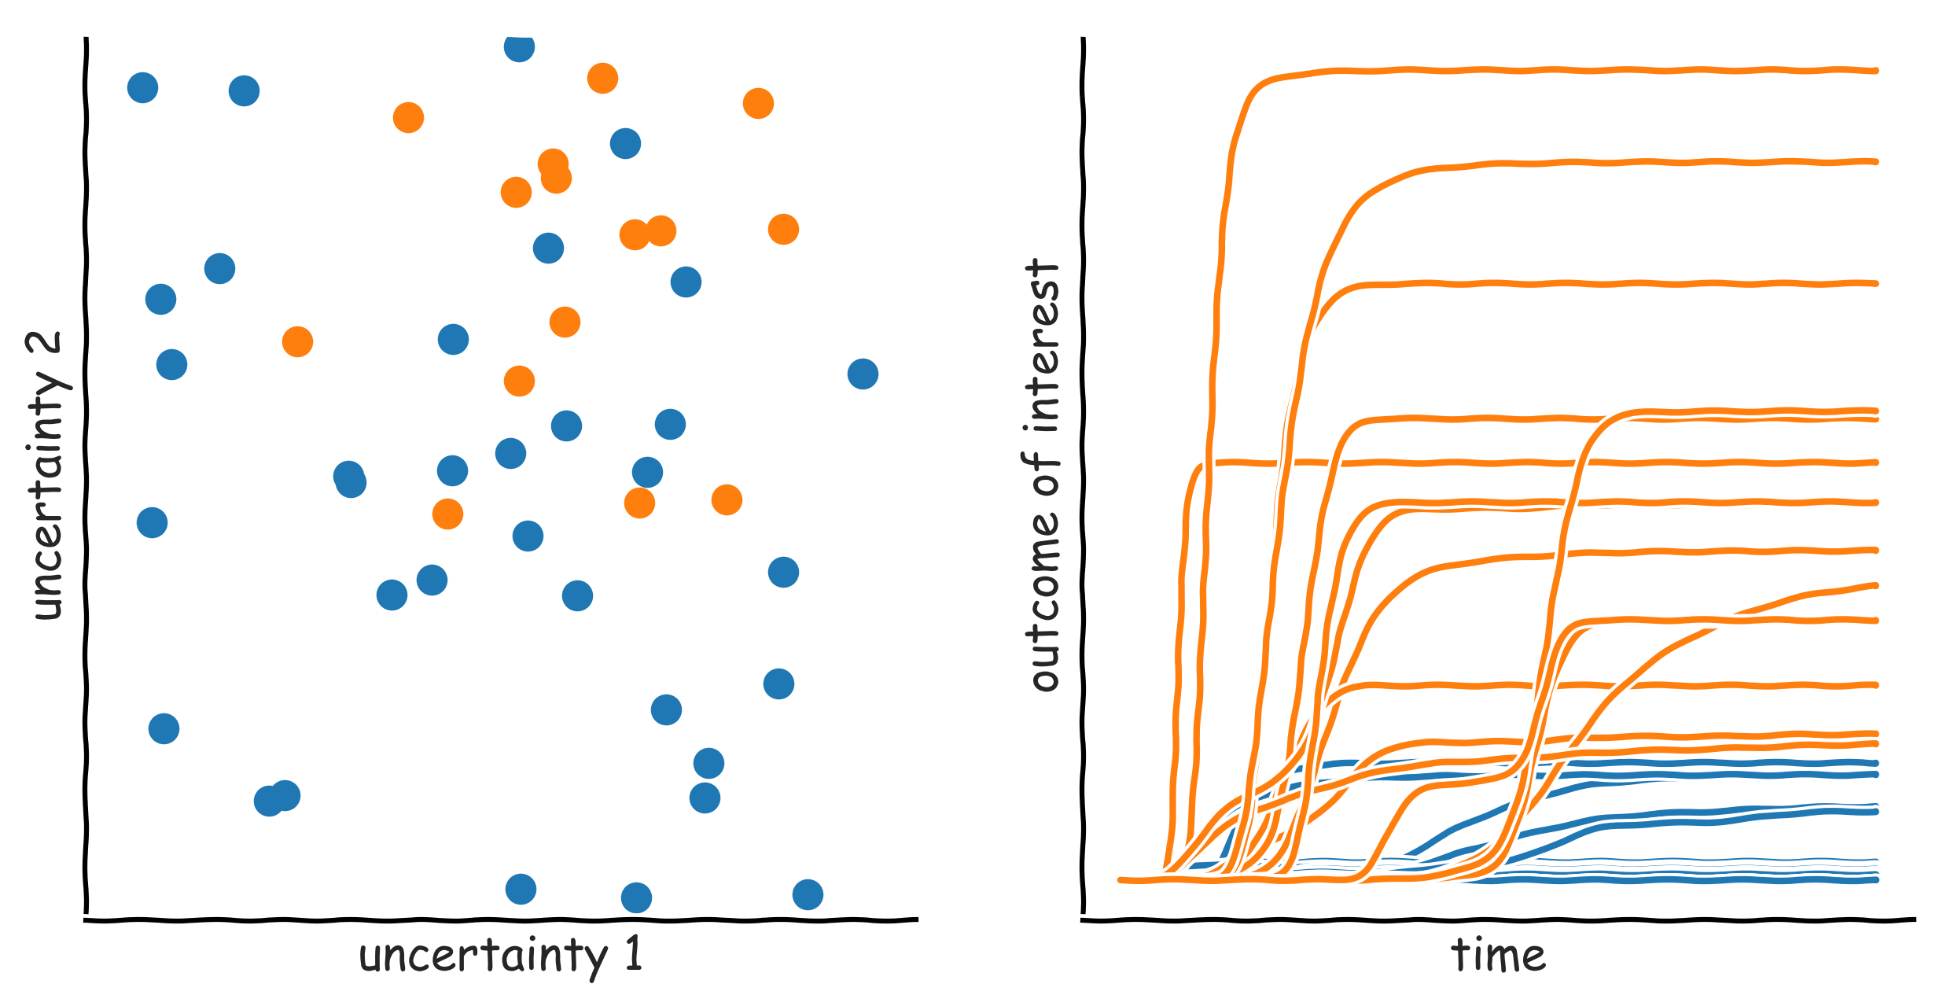
Exploratory modelling in a nutshell: scenario discovery

Slide 25
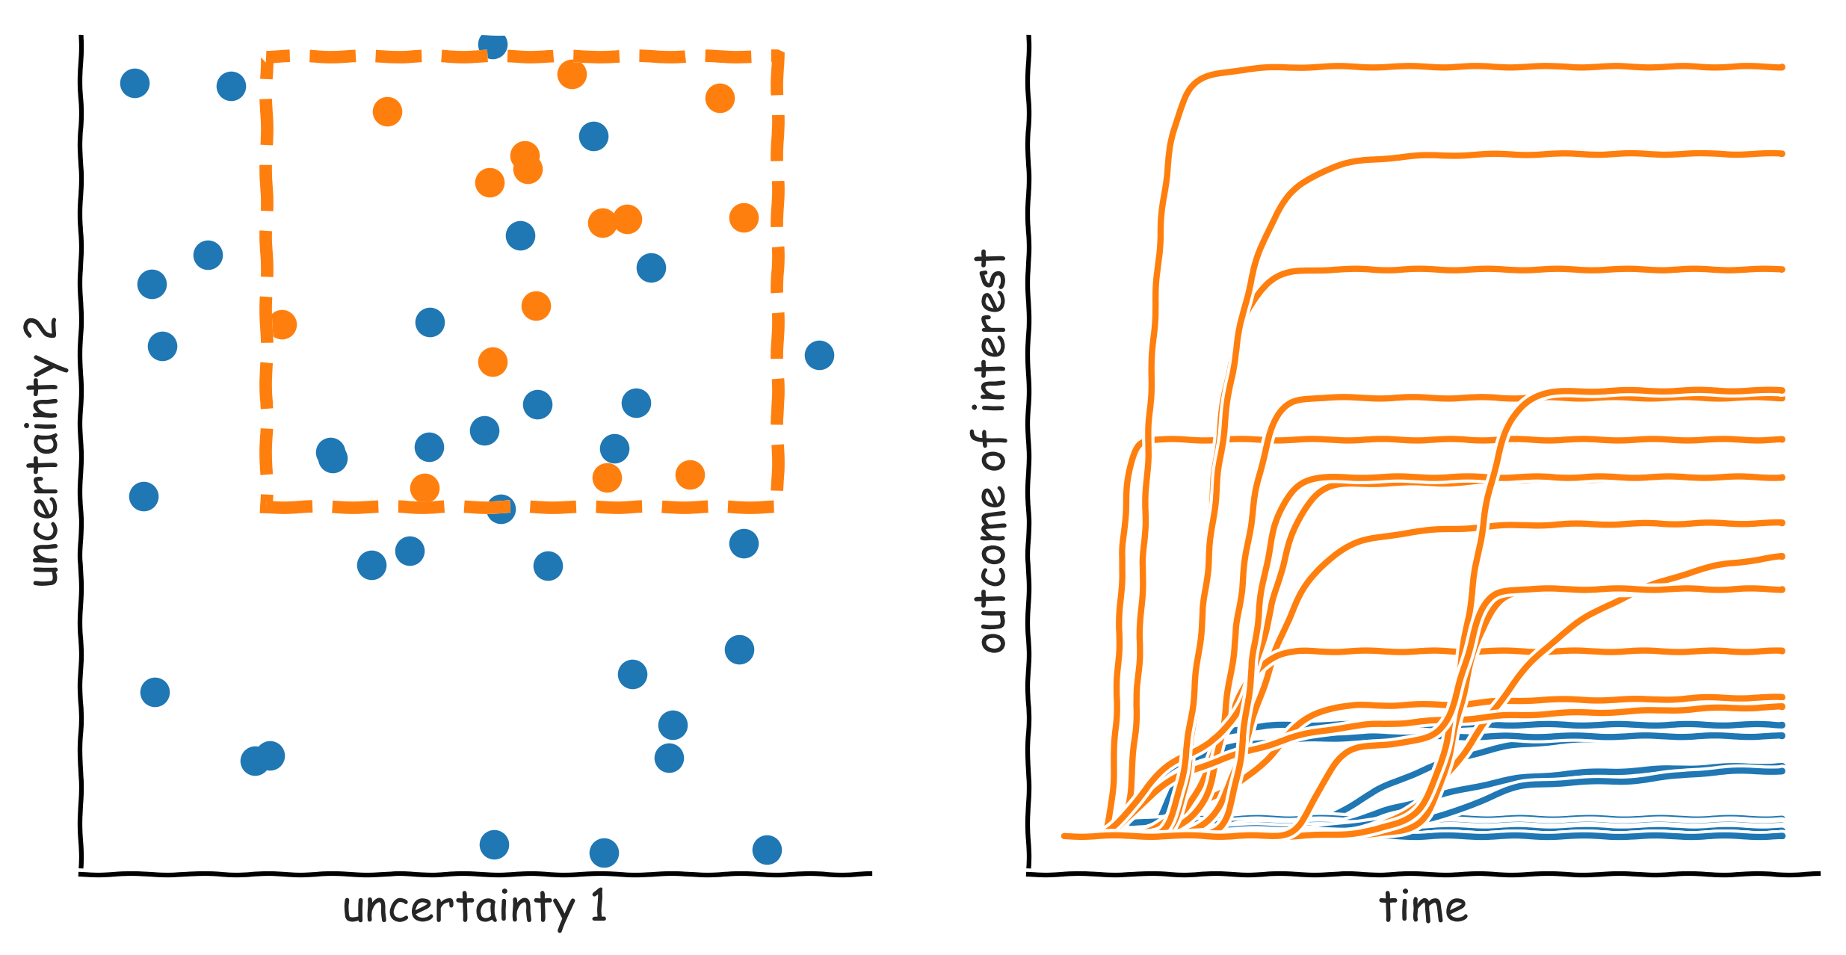
Exploratory modelling in a nutshell: scenario discovery

Slide 26
Manual scenario discovery exercise

Slide 27
Download

Slide 29
Scenario Discovery

Slide 30
Subspace partitioning
Problem: find an (orthogonal) subspace in the model input space, which has a high concentration of cases of interest
Rule induction problem
Regression vs. (binary) classification
Rule induction algorithms
Classification and Regression Trees (CART)
Patient Rule Induction Algorithm (PRIM
Various other more specialized possibilities

Slide 31
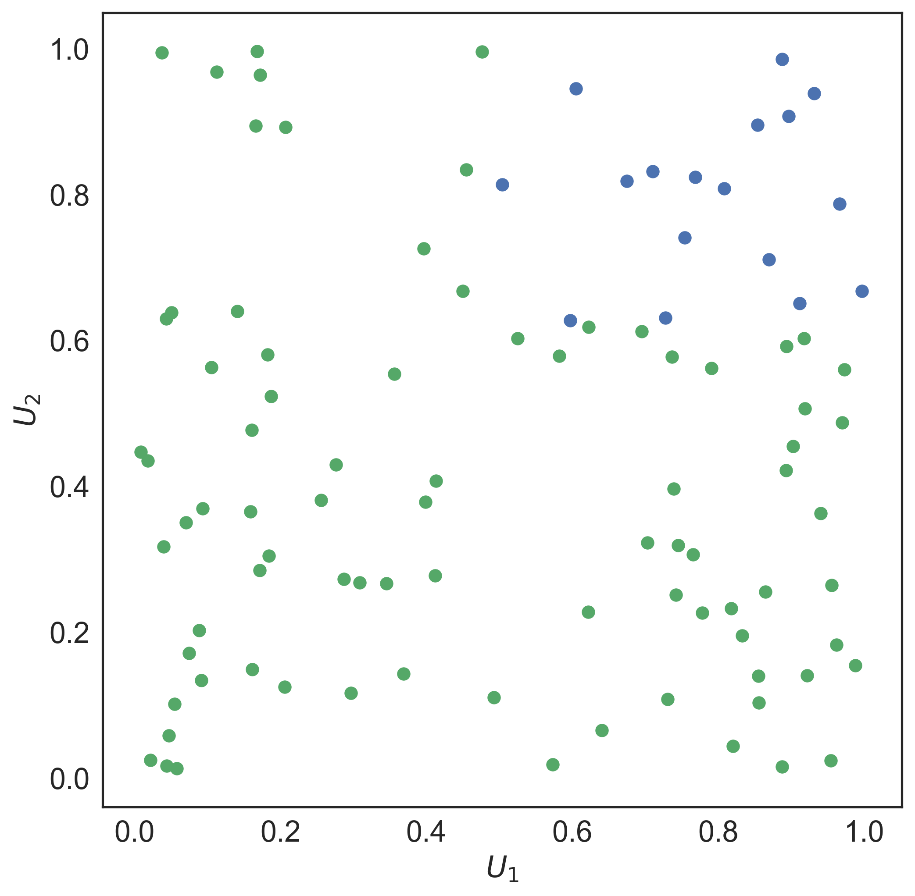
PRIM

Slide 32
PRIM
Lenient hill-climbing optimization algorithm
Each step in the optimization is stored → peeling trajectory
Coverage: fraction of cases of interest within the box
Density: fraction of cases in the box which is of interest
Interpretability: number of restricted uncertainties
Quasi p-values: one sided binomial test, proxy for statistical significance of each restricted uncertainty in isolation
Resampling statistic: do random subsets of the same dataset produce essentially the same box?

Slide 33
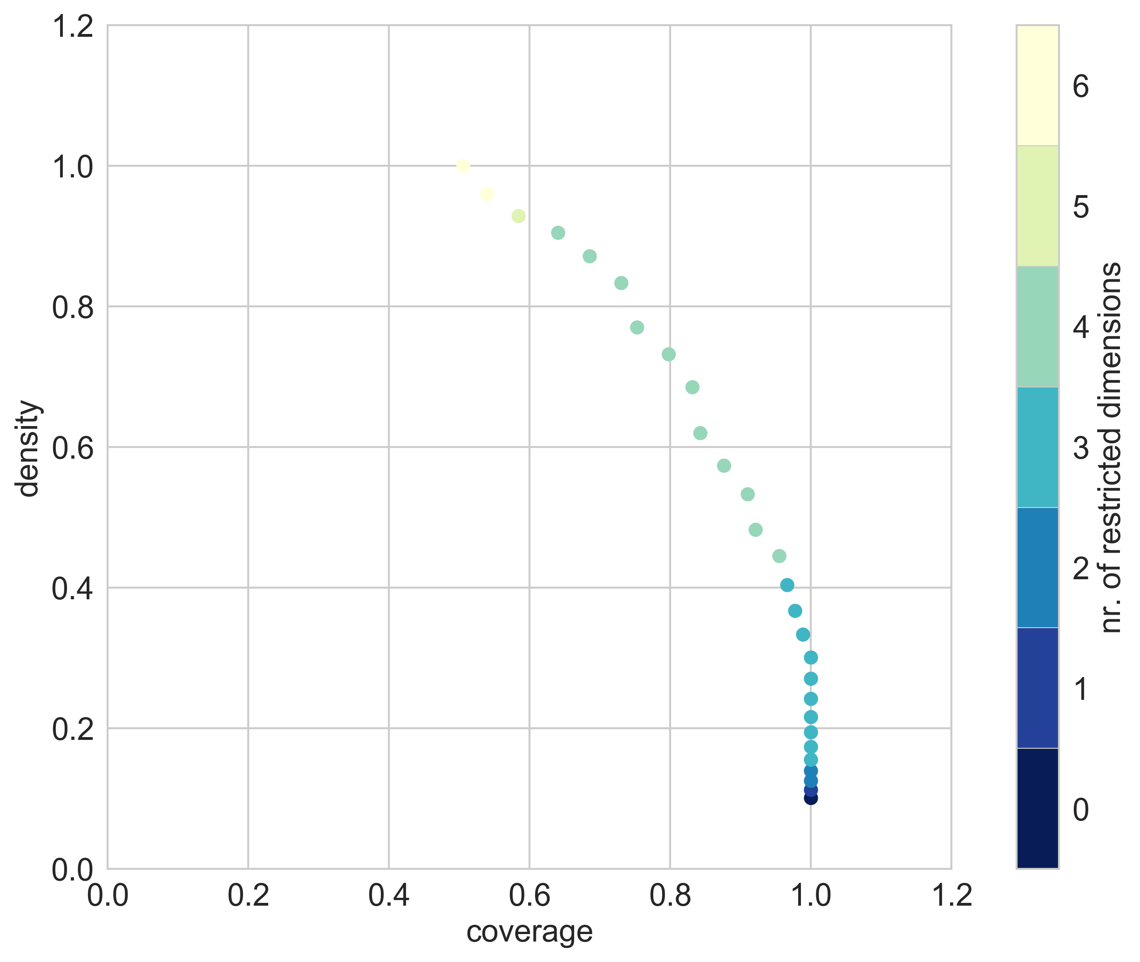

Slide 34
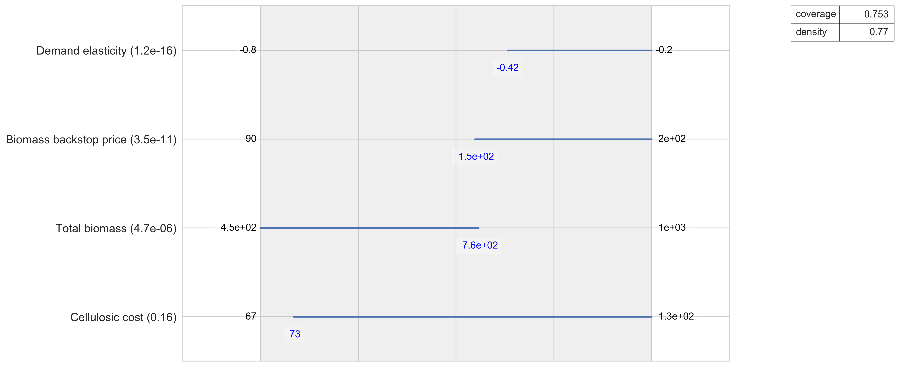

Slide 35
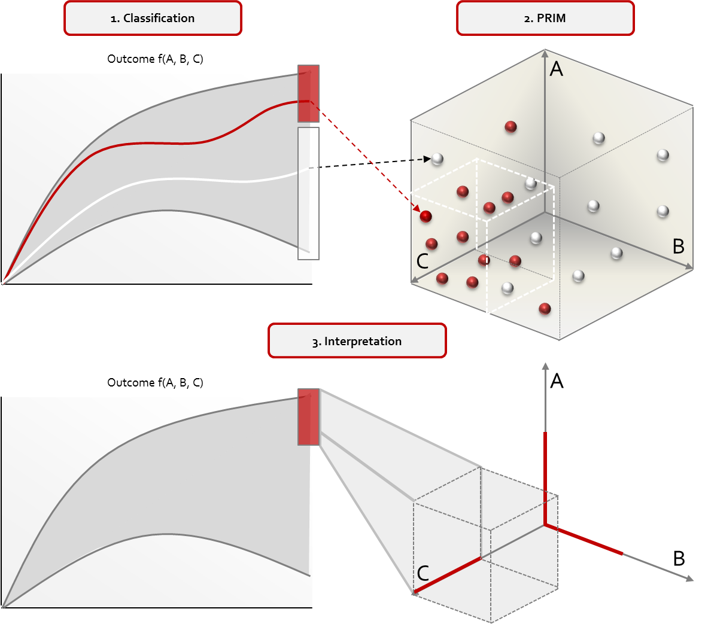
Scenario Discovery

Slide 36
Link scenario discovery results to adaptation tipping points

Slide 37
Scenario Discovery excercise

Slide 38
Introduction to MORDM

Slide 39
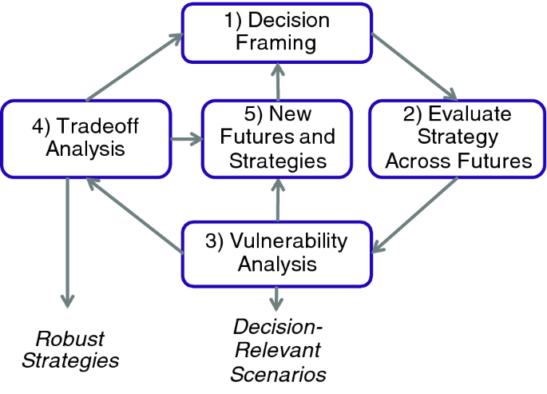
Robust Decision Making

Slide 40
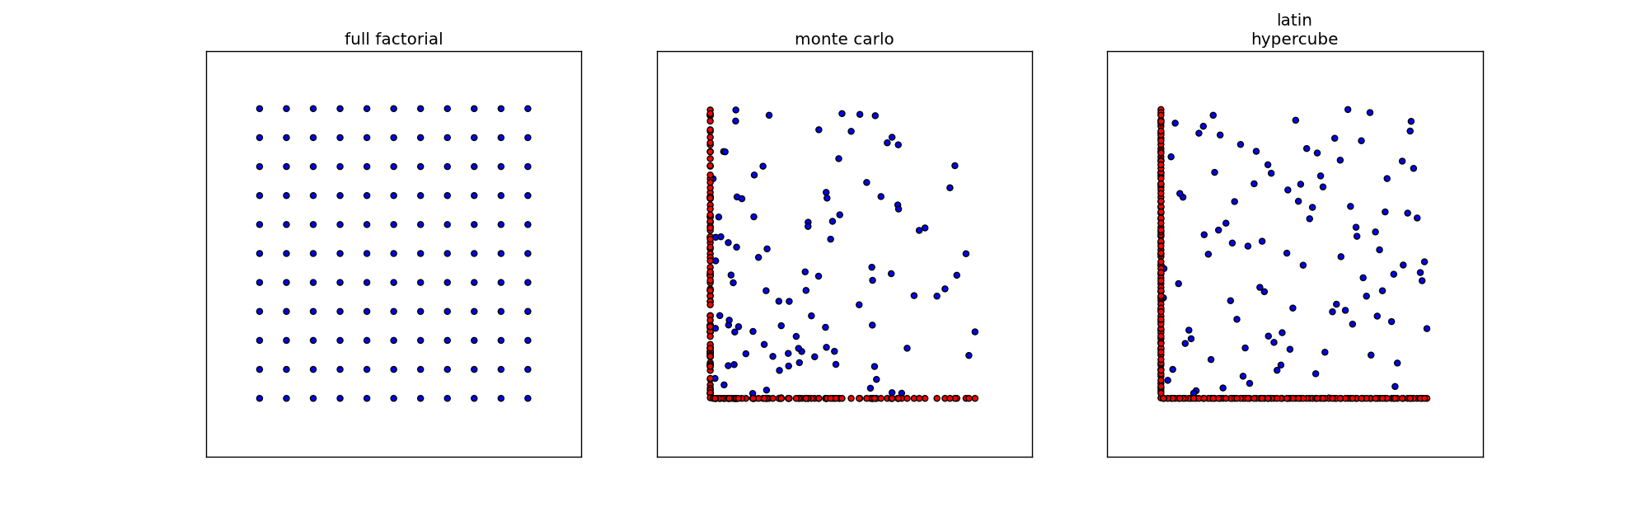
Experimental designs
Notes:
Figures show three sampling strategies with same number of samples (100)
For latin hypercube and monte carlo the red dots show the difference
Problem with full factorial is combinatory explosion.
Problem with lhs is generating it for many cases is memory intensive

Slide 41
Shift from RDM to MORDM
What if you do not have discrete and distinct options but rather varous (continuous) design variables?

Slide 42
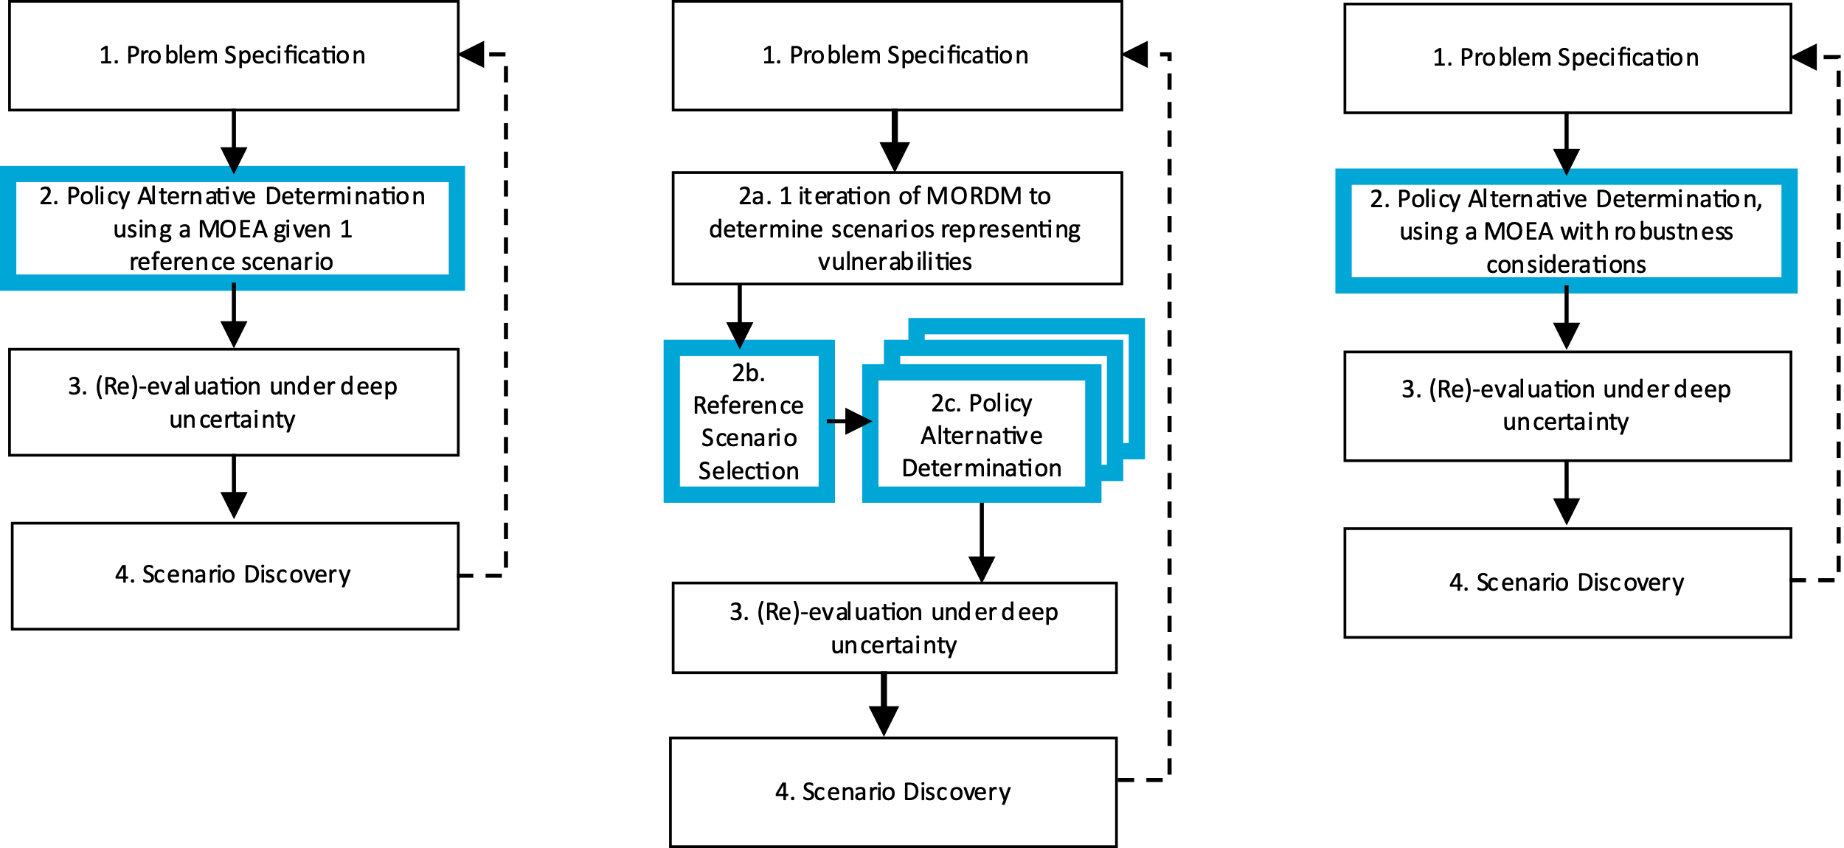
Robust decision making frameworks

Slide 43
Problematize optimization in light of value diversity

Slide 44
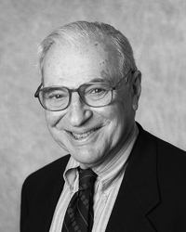
Arrow’s impossibility theorem
Kenneth Arrow, in 1950, demonstrated that there is no perfect voting procedure, it is either dictatorial or inherently unfair.

Slide 45
Arrow’s impossibility theorem
Individual preferences are ranked preferences (i.e. ordinal utility)
$A≻B≻C$
The goal is to arrive at an aggregate preference order of options given the individual preferences

Slide 46
Arrow’s impossibility theorem
Any voting procedure should be
1) Non-dictatorial: there is no single individual who’s preferences determine the aggregate preferences
2) Universal (complete ranking and deterministic): the final aggregate ranking should be complete, so no ties, and given a particular set of preferences of individuals always produce the same aggregate ranking
3) Independence of irrelevant alternatives: the preference relation between options A and B should not change if an option C is introduced which is always ranked lower than A and B
4) Pareto efficient: if option A is preferred by every individual over option B, than in the aggregate ranking option A should also be preferred over option B

Slide 47
Battling Arrow’s paradox
How can we account for Arrow’s paradox in any policy analytic activity?
Work with multiple objectives
Avoid the temptation to produce a complete ranking
Explore over alternative ways of formulating / framing a problem
Explore over alternative ways of aggregating over time and over scenarios
Key message: the policy analytic activity aims at helping decision makers understand the consequences of decision alternatives, and not to identify the best decision alternative

Slide 48
Pareto optimality
Premise: “A solution is Pareto optimal when improvements in one objective would degrade the performance in at least another objective”
Purpose: To rank alternatives in multi-objective problems.

Slide 49
Pareto dominance
A
Objective 2
B
C
Objective 1

Slide 50
Pareto dominance
A
Objective 2
B
C
D
Objective 1

Slide 51
Pareto dominance
A
Objective 2
B
C
D
Objective 1

Slide 52

Genetic Algorithms (GA)
Proposed in the 1970s by John Holland
Chromosome: Bit-string encoded candidate solution (nowadays other encoding forms are possible)
Gene: Each bit of the solution
A chromosome could represent the value of one or more parameters in your algorithm/system, e.g. the length of a robot arm, the value of weights in your neural network, the ids of operations you need to execute in a sequence…

Slide 53
John Holland—GA’s as Complex Adaptive Systems
Why simulate evolution for optimization?
Requires only distinguish “functional benefits” of adaptations
“Performance-based Random Process”: does not require detailed problem information (i.e., derivatives) and all pathways may be reachable
Breadth of application (real/discrete choices, uncertainty, nonlinearity)
Simple to link to complex simulations

Slide 54
Basic structure of an MOEA
population = initialize_population(population_size)
evaluate_objective_function(population)
non_dominated_sort(population)
selected = select_parents(population, population_size)
children = crossover_and_mutate(selected, p_crossover,p_mutation)
while(not stopping_condition()):
evaluate_objective_function(children)
union = population+children
non_dominated_sort(union)
selected = select_parents(union, population_size)
population = children
children = crossover_and_mutate(selected, p_crossover, p_mutation)

Slide 55
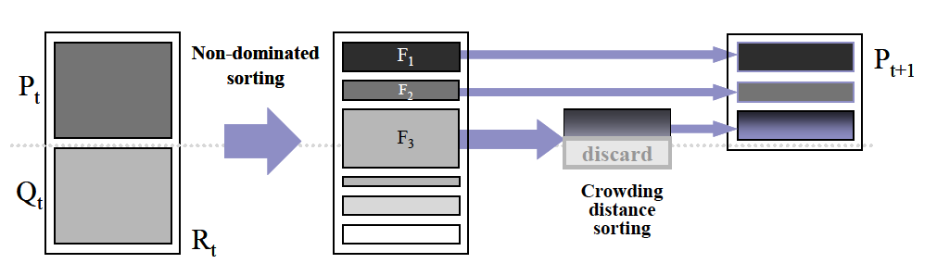
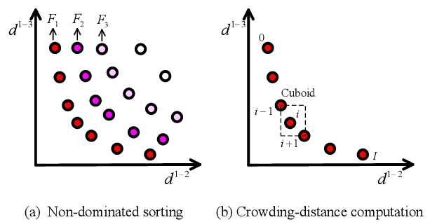
NSGAII (classic, but outdated)
1) Initial population
3) Rank the fitness of the population
Parent
population
2) Genetic
Operators:
Selection+
Mutation+
Crossover
Offspring
population
Key components:
1) Non dominated sorting
2) Crowding indicator for diversity maintenance

Slide 56
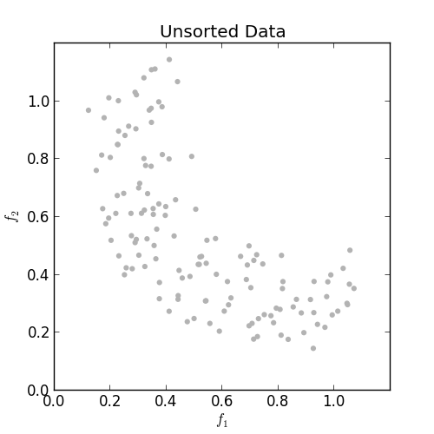
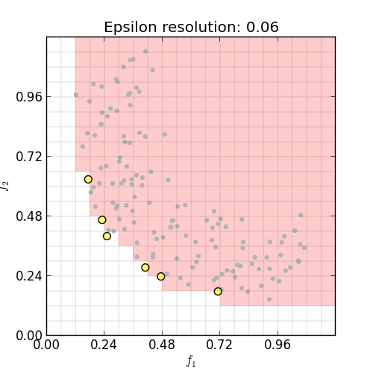
Epsilon dominance- better alternative to preserve diversity and scalability
Keeps the solution bounded and stable (important when increasing dimensionality)
Preserve diveristy
Taken from https://github.com/matthewjwoodruff/pareto.py

Slide 57
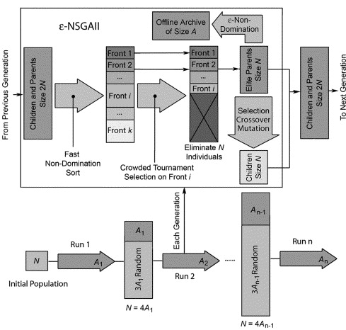
EPSILON-NSGAII
Key components:
Epsilon dominance for diversity maintenance
2) Auto-adaptive population sizing

Slide 59
MORDM excercise

Slide 60
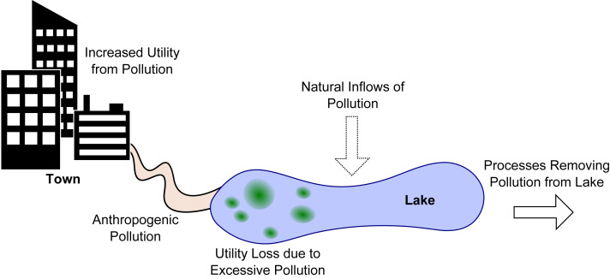
Shallow lake problem
How much anthropogenic pollution to release into the lake, while avoiding that the lake tips into an irreversible eutrophic state?
Adaptive version: what is a state based control rule that tells how much can be released?
Hadka et al (2015). 10.1016/j.envsoft.2015.07.014.

Slide 61
Workflow
Connect model to the workbench
X: uncertainties
L: levers which parameterize the control rule
R: model of the shallow lake
M: outcomes of interest
Develop basic system understanding by exploring the behavior of the system for one or more basic policies (i.e. control rules)
Optimize policies for a reference scenario
Re-evaluate (selected) policies over a much larger ensemble of scenarios
Analyze robustness and vulnerabilities (i.e., scenario discovery)
Iterate if necessary

Slide 62
Robustness metrics

Slide 63
McPhail, C., et al (2018). "Robustness metrics: How are they calculated, when should they be used and why
do they give different results?" Earth's Future. 10.1002/2017EF000649

Slide 64
Robustness metrics
deeply uncertain factor 1
deeply uncertain factor 2
deeply uncertain factor 3
KPI’s per
scenario
Distribution per kpi over scenarios
policy
How to summarize the distribution over scenarios in (preferably) one number?
Robustness per kpi, or one robustness number per policy?
Figure adapted from Trindade et al. (2019) https://doi.org/10.1016/j.advwatres.2019.103442

Slide 65
3 families of robustness metrics
Satisficing robustness
Absolute: the observed performance of a policy in each scenario compared to an absolute performance threshold
Regret
Relative: the difference between the observed performance of a policy in each scenario and the performance of some reference policy for each scenario
Descriptive statistics
Characterizing the distribution of performance of a policy over the set of scenarios using one or more moments of the distribution

Slide 66
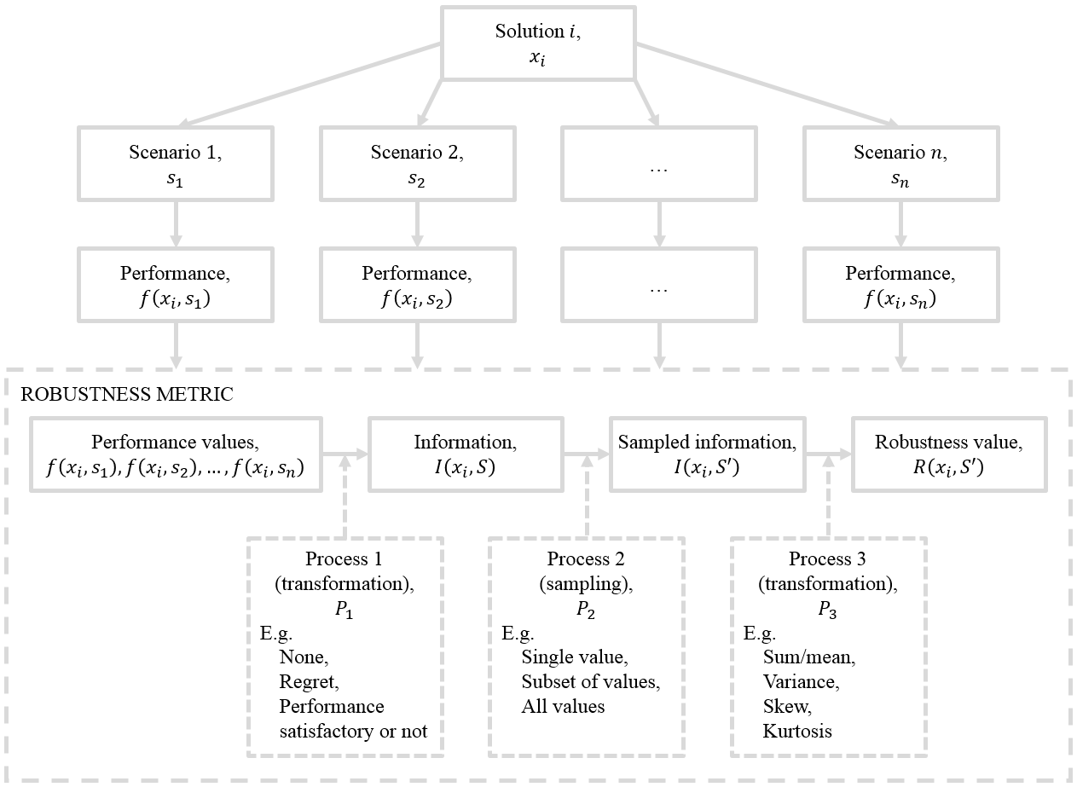
Robustness calculation
McPhail, C., et al (2018). "Robustness metrics: How are they calculated, when should they be used and why
do they give different results?" Earth's Future. 10.1002/2017EF000649

Slide 68
MORDM exercise continued

Slide 69
Some example applications of (MO)RDM

Slide 70

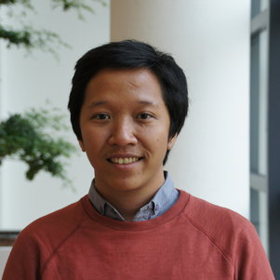

Income inequality in the Vietnam Mekong Delta
Bramka Arga Jafino
Maaike van Aalst
Notes:
Many talk about climate migration from the mekong
But real story is quite more complicated
So we created a simulation model to better understand what is happening and to identify possible interventions that address inequality

Slide 71
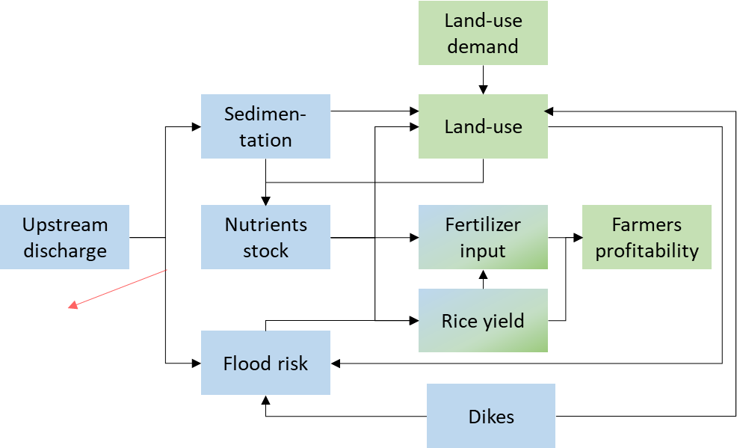
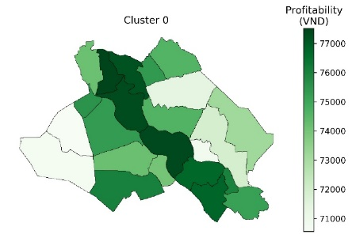
Adaptation policies
more high dikes
less high dikes
fertilizer subsidies
seed upgrade
Uncertainties
river discharge
upstream dam development
farming preferences
drought impacts
Performance indicators
District level profitability
Integrated assessment model
Notes:
Walk through the modeling work

Slide 72
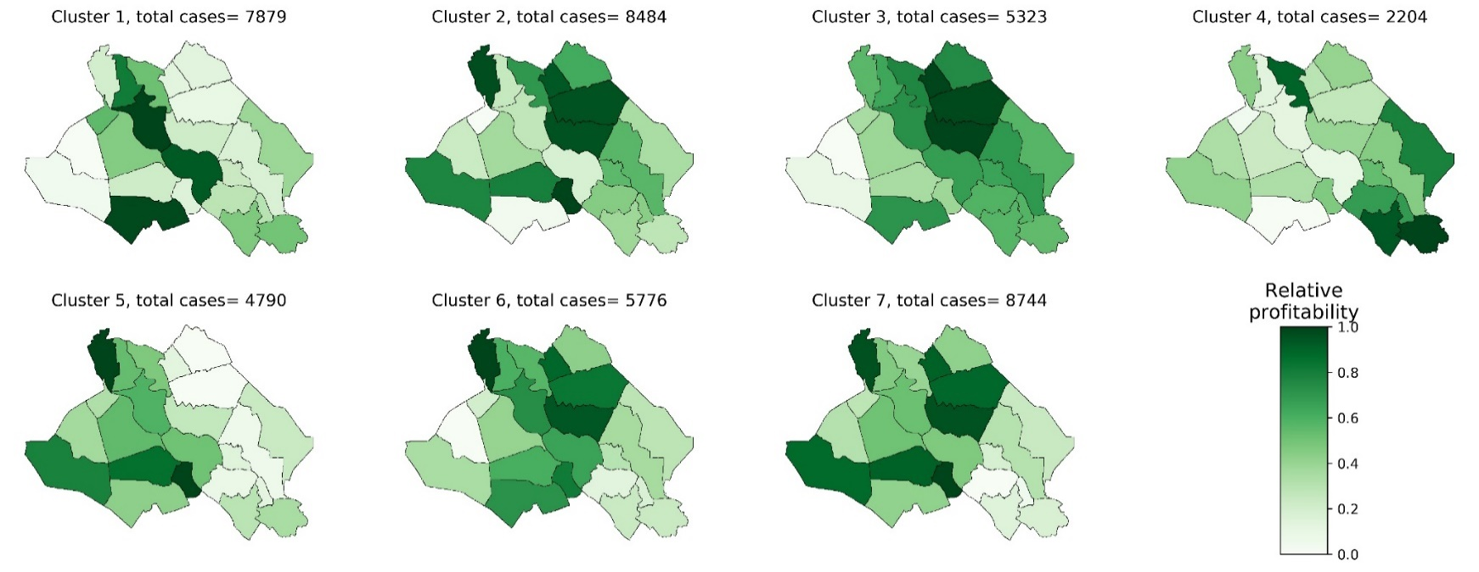

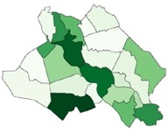
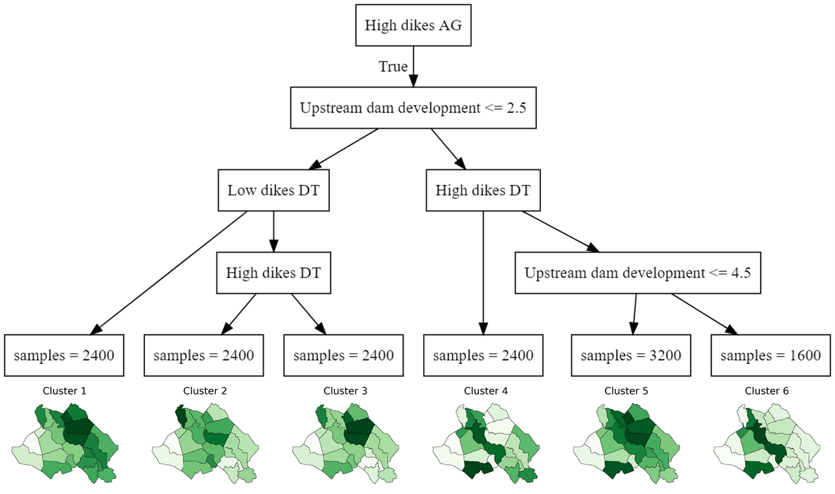
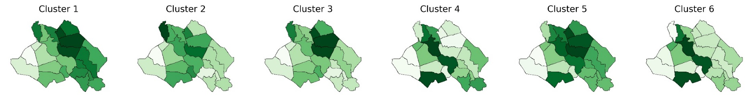
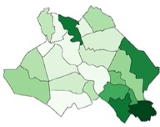
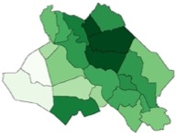
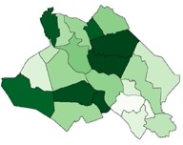
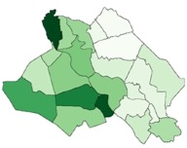
How can income patterns change?
43K scenarios
7 archetypical
income patterns
Classification tree mapping uncertainties and policies to types of income patterns

Slide 73
How can income patterns change?
43K scenarios
7 archetypical
income patterns
Classification tree mapping uncertainties and policies to types of income patterns

Slide 74
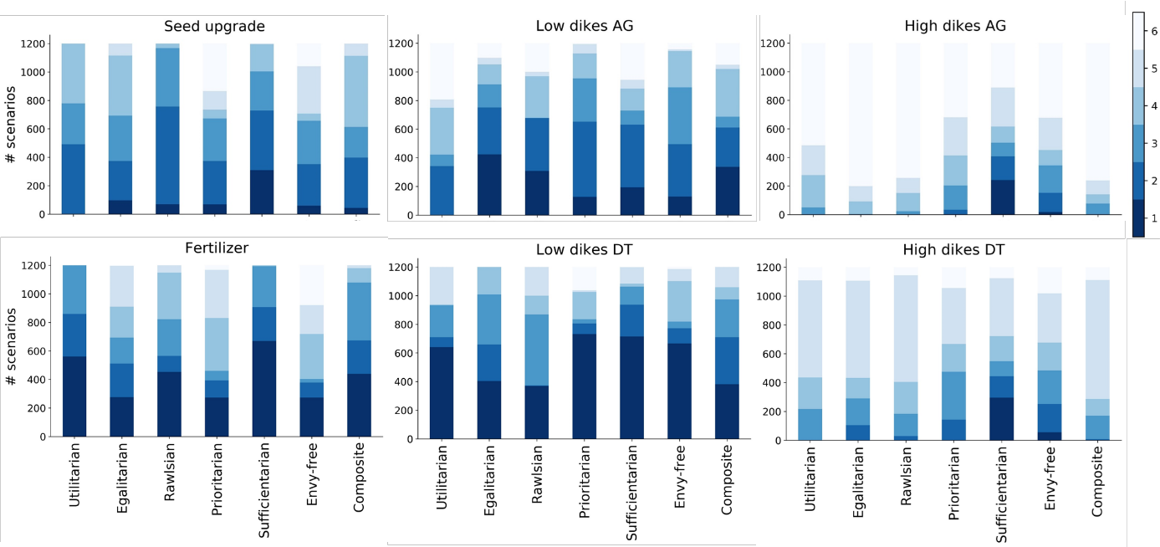
How sensitive are rankings to normative assumptions?

Slide 75
Research triangle

Slide 76
Closing remarks

Slide 77
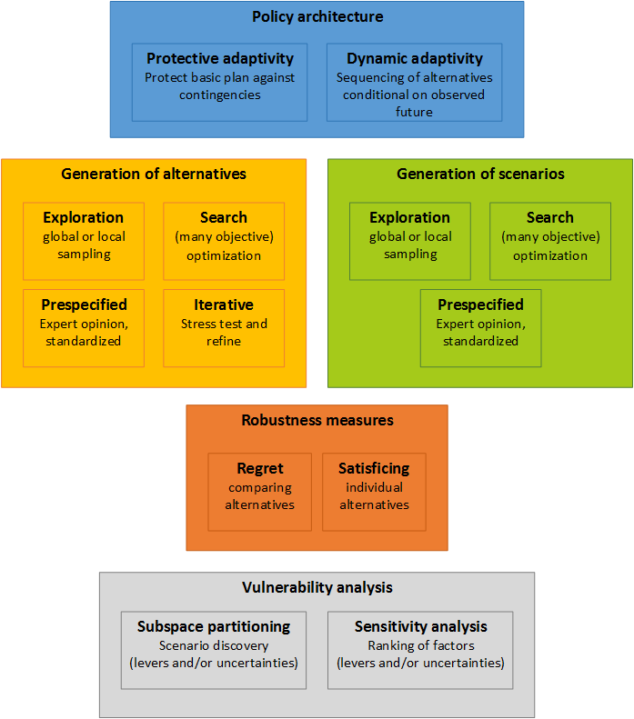
Kwakkel & Haasnoot (2018) Supporting decision making under deep uncertainty: a synthesis of approaches and techniques

